Slide 1


Card Suite Lite User
Upgrade Experience

Slide 2

AGENDA
Things needed to upgrade to Card Suite Lite
Your mobile phone
Access to your email registered with Tri Boro FCU
Details of the credit and/or debit card
**Please note that images in this guide may be slightly different than the actual upgrade experience.

Slide 3

Setting up your account

Slide 4
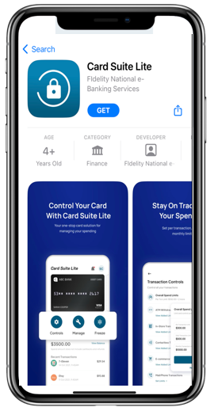
Download the card suite Lite app
Download the Card Suite Lite app from the Apple App Store or Google Play Store.

Slide 5
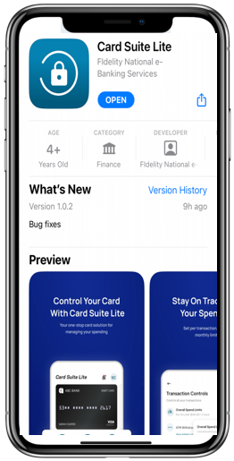
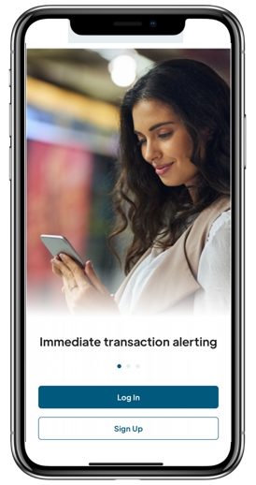
SETTING UP YOUR CARD SUITE LITE ACCOUNT
Open the app and click Log In.

Slide 6
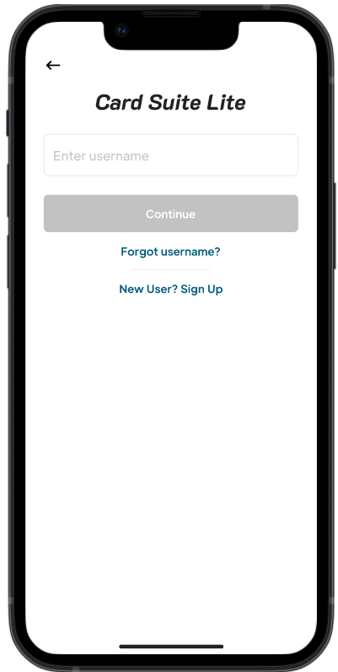
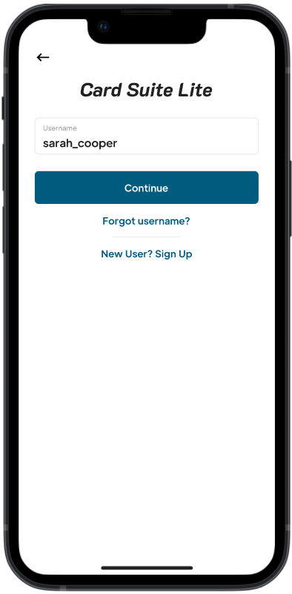
SETTING UP YOUR CARD SUITE LITE ACCOUNT
Enter the username that you logged into SecurLOCK Equip with and click Continue.

Slide 7
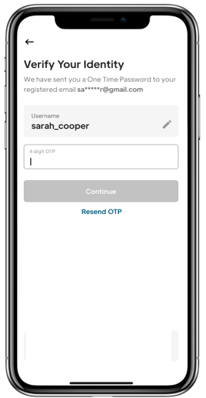
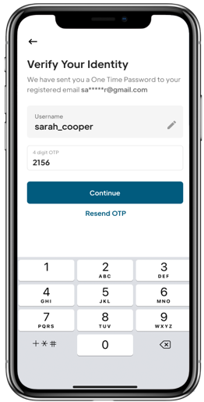
Verify your identity
A one-time passcode will be sent to the email registered to your SecurLOCK Equip account.
Enter the OTP on the Verify Your Identity page.

Slide 8
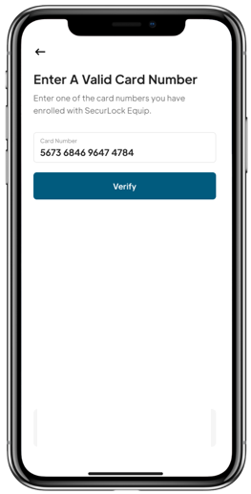
Enter a Valid card number
Enter the card number for one of the cards enrolled in SecurLOCK Equip.

Slide 9
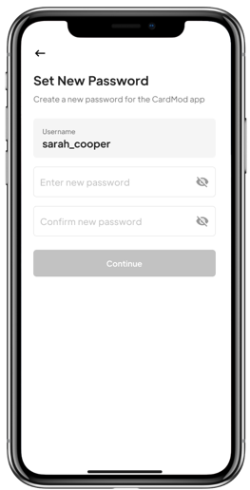
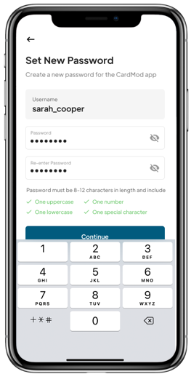
Create a new password
Create a new password and click continue.
Note: The password must contain one upper case, one lower case, one number and one special character.

Slide 10
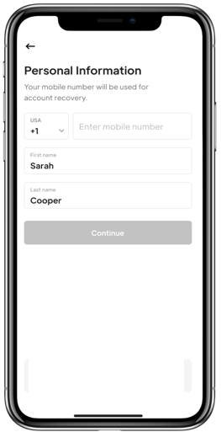
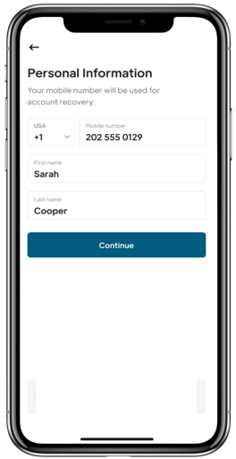
Personal information
Enter your mobile phone number and name.

Slide 11
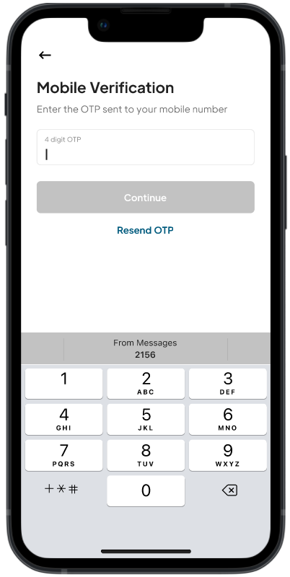
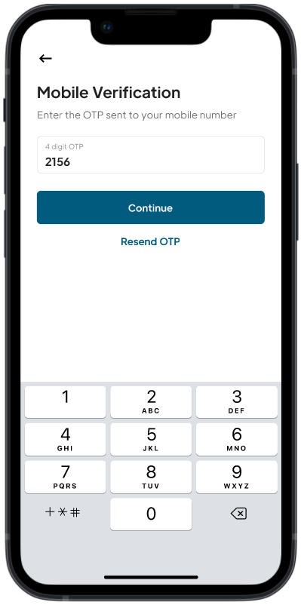
Mobile Verification
An OTP will be sent to the mobile number entered. Enter the OTP on the Mobile Verification page.

Slide 12
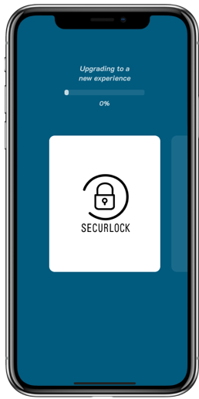
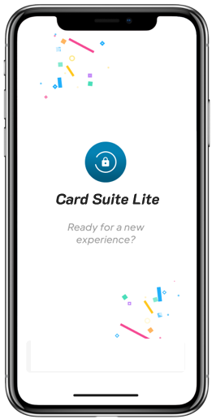
Card Suite Lite upgrade
Card Suite Lite will be updated with your information and existing card controls.

Slide 13
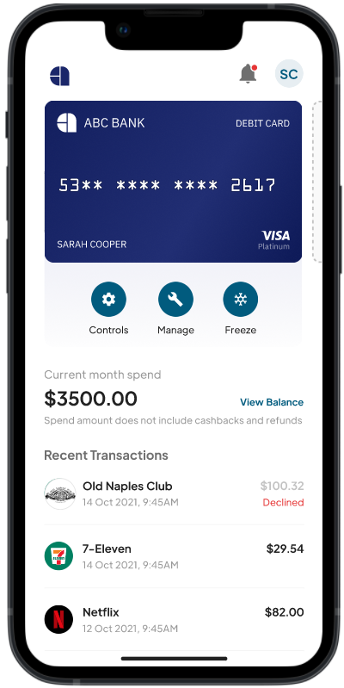
Card suite lite is ready to use
Validate the controls and limits you previously had set up in SecurLOCK Equip:
  Controls including transaction, merchant and International location
  Spend limits
  Note: Location Shield and Region Shield will need to be enabled if required as this control did not move as part of the upgrade process.

Slide 14


